Slide 1
Introduction to WatchGuard Dimension™ v2.0.1

Slide 2
Introduction to Dimension
What is WatchGuard Dimension?
Deploy WatchGuard Dimension
Set Up WatchGuard Dimension
Configure WatchGuard Dimension
Use WatchGuard Dimension
Support WatchGuard Dimension

Slide 3
What is Dimension?

Slide 4
What is WatchGuard Dimension?
Secure and centralized logging, visibility, reporting, and management for Firebox devices and WatchGuard servers
New ways to visualize network data
Dashboards with simple drill-down operation into log and report information
Customizable reports that can be emailed to different roles in the organization
Complements Fireware Web UI visibility tools for Fireware OS v11.8.x and higher
Reports available after the first summary report period (5 minutes)
All reports are on-demand all the time

Slide 5
What is WatchGuard Dimension?
Cloud-ready zero-installation deployment
Delivered as a virtual appliance for ESXi (.ova) and Hyper-V (.vhd)
Runs on 64-bit Linux
Driven by PostgreSQL 9.2
Web interface supports most desktop and mobile browsers

Slide 6
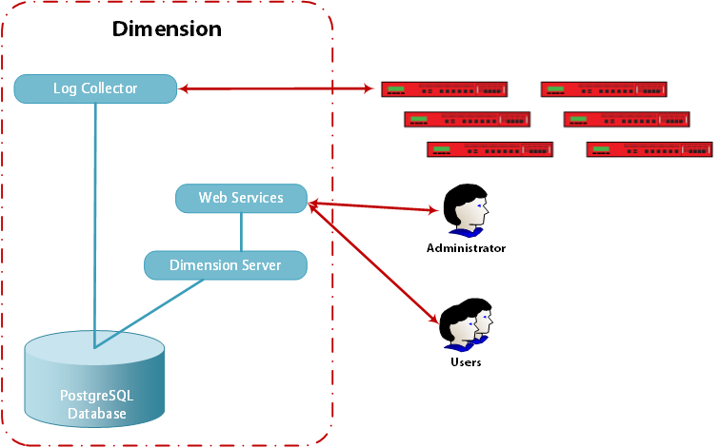
Dimension Architecture
Log Collector
Receives log messages from Firebox devices
Aggregates data
Web Services
Serves web application to users and administrators
Interface for device management and visibility

Slide 7
Dimension Architecture
Dimension Server
Provides API for log data, provisioning, maintenance, and configuration
Database
Persistent storage for:
Log and report data
Device configuration files

Slide 8
Deploy Dimension

Slide 9
Deployment Requirements
WatchGuard Dimension is distributed as an .ova file for installation on VMware ESXi 5.x–6.x and a .vhd file for installation on Hyper-V.
Your VM host must support 64-bit guest operating systems
WatchGuard Dimension has been primarily tested on VMWare ESXi hypervisors and Microsoft Hyper-V. It can also be installed in VMware Workstation, Player, Fusion environments, and other Hyper-V platforms, which is a great option for training and demonstration.

Slide 10
Deployment Requirements
WatchGuard Dimension is available on the WatchGuard website Software Downloads pages.
Log in to WatchGuard.com.
Select Support Home.
Click Software Downloads.
From the Show downloads for drop-down list, select Dimension.
Download the current version of Dimension and the Release Notes.

Slide 11
Deployment Notes
The Dimension VM default data disk size is 40GB.
If you use the built-in PostgreSQL database, the data disk is fully reserved for the log database and the related overhead space required by PostgreSQL.
After the Dimension VM is deployed, the data disk size cannot be reduced.
To limit the size to be less than 40GB and avoid data loss, you must remove and add Hard disk 2 again, before you power on the VM for the first time.
After your VM is powered on, you see the IP address assigned to Dimension through DHCP.

Slide 12
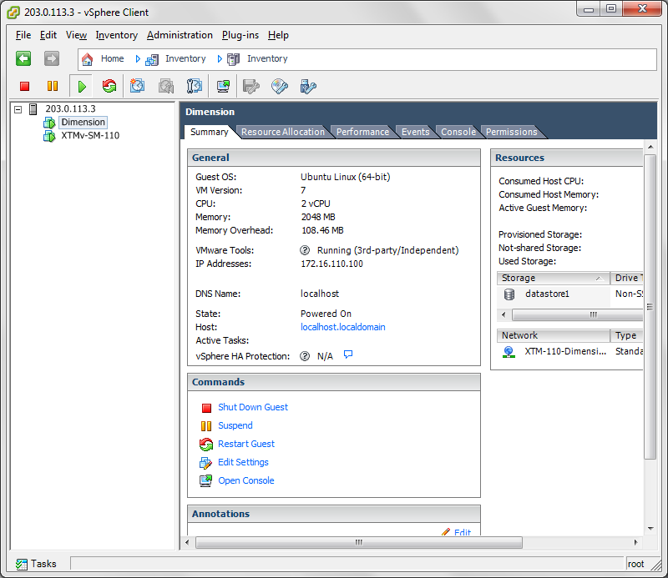
Deployment Notes
If you do not have a DHCP server, you must make a console connection to your Dimension VM, and set a static IP address.
Use this IP address to make an HTTPS connection to Dimension and start the Dimension Setup Wizard.

Slide 13
Set Up Dimension

Slide 14
Dimension Requirements
WatchGuard Dimension supports these web browsers:
Firefox v22 and higher
Internet Explorer 9 and higher
Safari 5 and later
Safari on iOS 6 and higher
Chrome v29 and higher
Note: The Dimension FireWatch feature requires browser versions that support HTML5.
You should be able to successfully use WatchGuard Dimension on most mobile phone and tablet devices.
Connect to Dimension in a web browser at https://<dimension-IP-address>

Slide 15
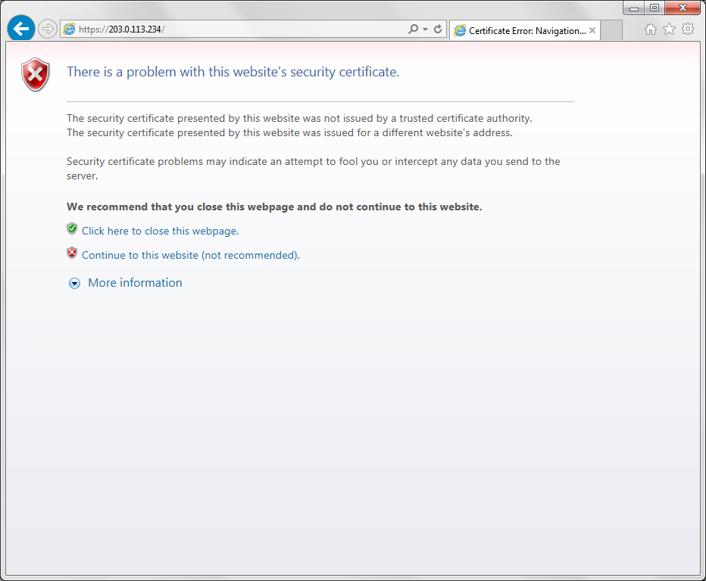
WatchGuard Dimension Setup Wizard
Accept the security warning to continue to connect to Dimension.

Slide 16
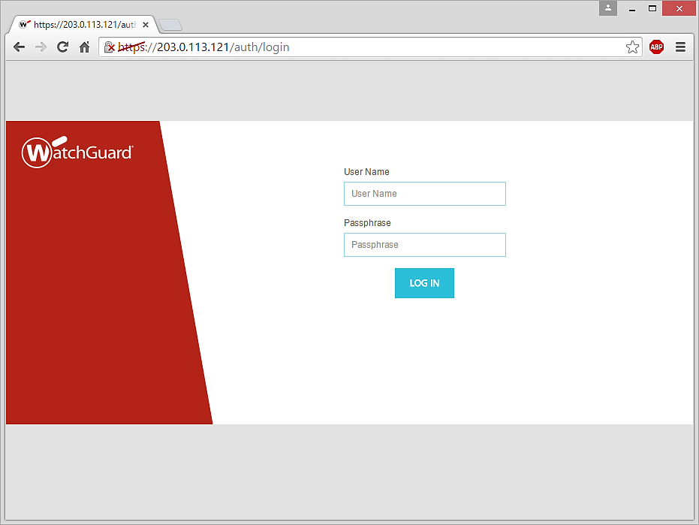
WatchGuard Dimension Setup Wizard
Log in with these credentials:
User Name — admin
Password — readwrite

Slide 17
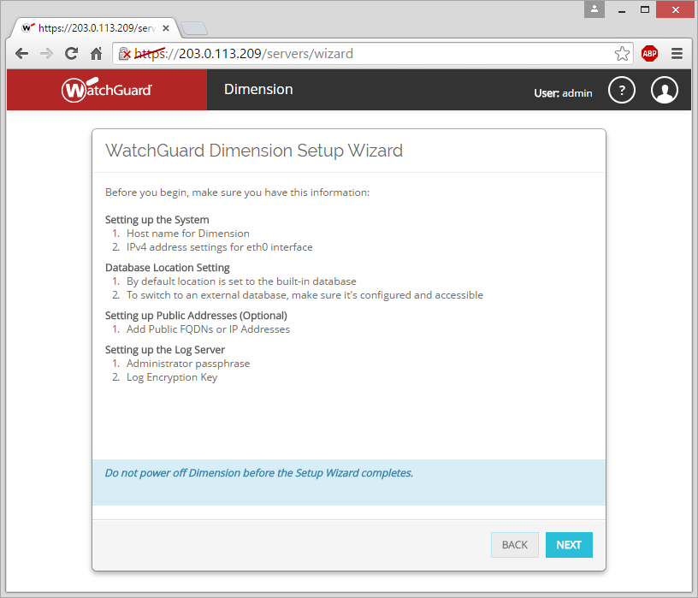
WatchGuard Dimension Setup Wizard
Make sure you have this information before you start the Dimension Setup Wizard:
Host name
IPv4 address and settings for the Eth0 interface
Administrator passphrase
Log Encryption Key

Slide 18
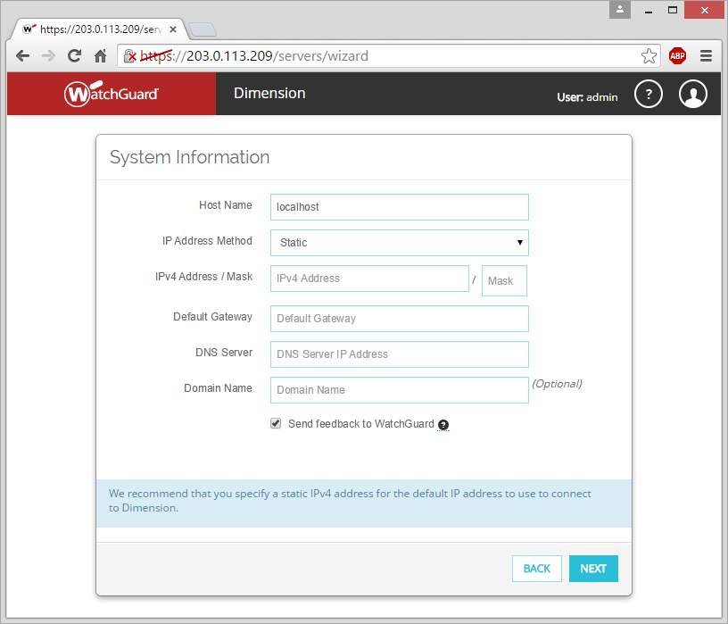
WatchGuard Dimension Setup Wizard
Specify the host name for Dimension
Select the IP address method:
Static
DHCP
For a static IP address, we recommend that you specify an IPv4 address.

Slide 19
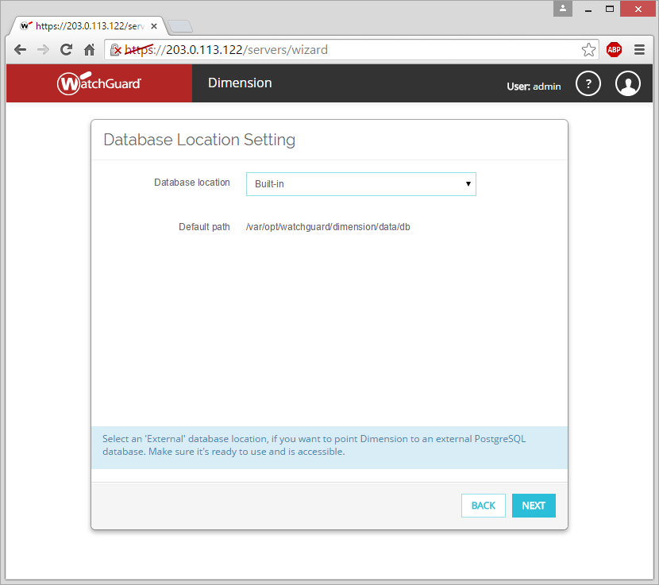
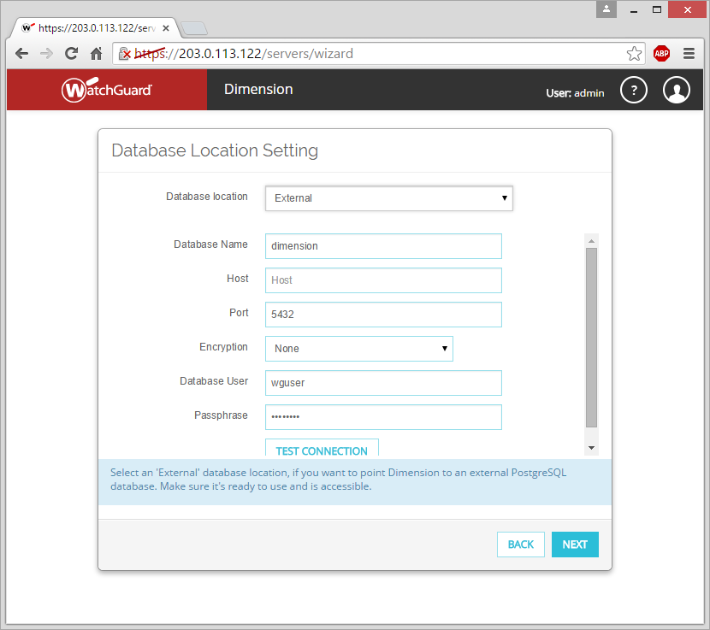
WatchGuard Dimension Setup Wizard
Select the location of the Dimension database:
Built-in
External

Slide 20
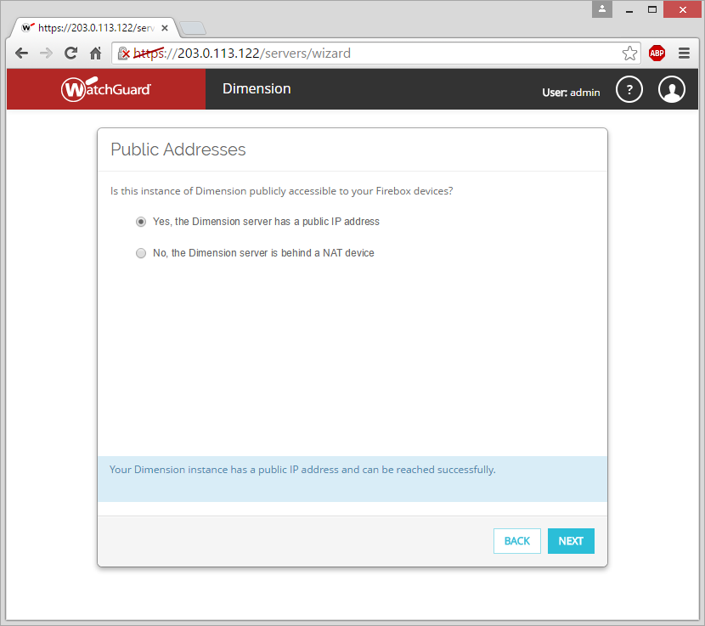
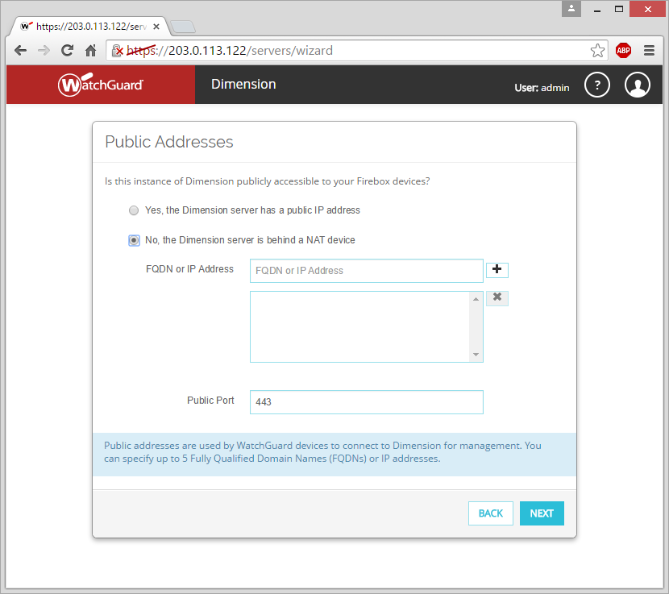
WatchGuard Dimension Setup Wizard
Specify whether Dimension has a public IP address or if it is behind a NAT device (such as a gateway Firebox)

Slide 21
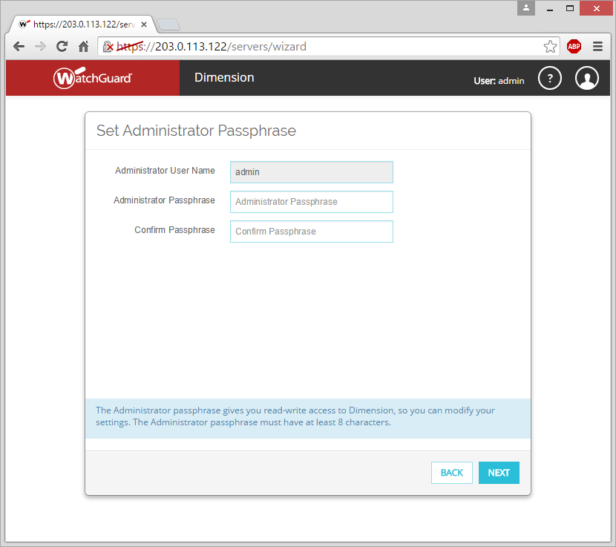
WatchGuard Dimension Setup Wizard
Set the Administrator Passphrase to use to connect to Dimension and manage the Dimension server.
The Administrator Passphrase must have a minimum of 8 characters.

Slide 22
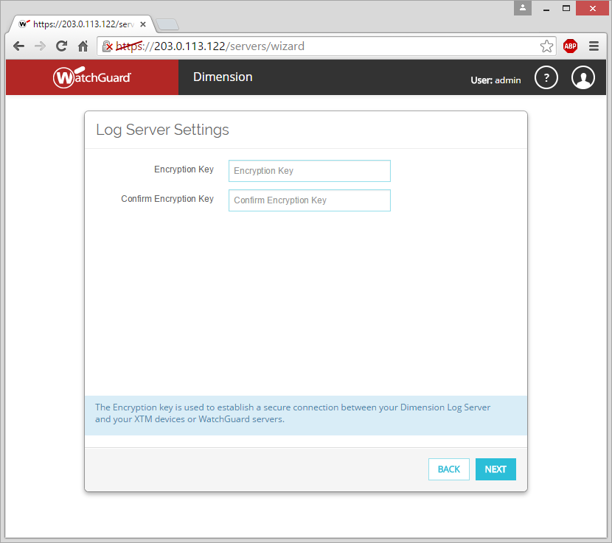
WatchGuard Dimension Setup Wizard
Set the Log Encryption Key.

Slide 23
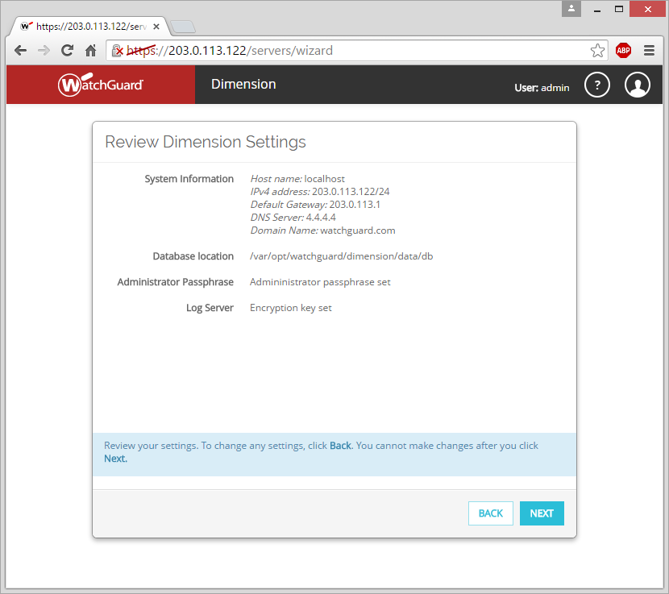
WatchGuard Dimension Setup Wizard
Review and confirm your settings for Dimension.

Slide 24
Send Log Messages to Dimension
WatchGuard Dimension can accept log messages and generate reports for any Firebox that runs Fireware OS.
WatchGuard Dimension can also accept log messages from a WatchGuard Management Server or Quarantine Server.
When you configure the WatchGuard Log Server settings for your Firebox, specify the IP address and Encryption Key for your instance of Dimension.
On WatchGuard servers, use the same IP address and Encryption Key in the Logging settings.

Slide 25
Send Log Messages to Dimension
In some environments, you might use NAT for the HTTPS and WatchGuard logging connections through your Firebox. This changes the IP address you use to connect to WatchGuard Dimension and where you send WatchGuard logging connections.

Slide 26
Send Log Messages to Dimension
Enable Logging For… | Reports | Dashboards
Packet Filter Allowed Logs | Web, Packet Filter, Top Client, Application Control | Executive, Threat Map, FireWatch, Policy Map
Packet Filter Denied Logs | Web, Packet Filter, Denied Packet, Top Client, Application Control | Security, Threat Map, Policy Map
APT Blocker | Advance Malware (APT) Summary and Detail reports, and Zero-Day Malware (APT) PCI Compliance, Executive Summary PDF | Executive, Security, Policy Map
Intrusion Prevention Service | IPS, Denied Packet | Security, Threat Map, Policy Map
Log when configuration has changed | Authentication, Audit
All Proxies: Enable logging for reports | GAV, IPS, SPAM, Application Control | Executive, Security, Threat Map, FireWatch, Policy Map
HTTP Proxies: Enable logging for reports | Web, Firebox Statistics, RED | Executive, Security, Threat Map, FireWatch, Policy Map
FTP Proxies: Enable logging for reports | Firebox Statistics | Executive, Security, Threat Map, FireWatch, Policy Map
SMTP Proxies: Enable logging for reports | SMTP, Firebox Statistics | Executive, Security, Threat Map, FireWatch, Policy Map
POP3 Proxies: Enable logging for reports | POP3, Firebox Statistics | Executive, Security, Threat Map, FireWatch, Policy Map
WebBlocker Actions Select Categories > Log this action | Web Audit | Executive, Security, Threat Map, FireWatch, Policy Map
Any alarms | GAV, Alarms

Slide 27
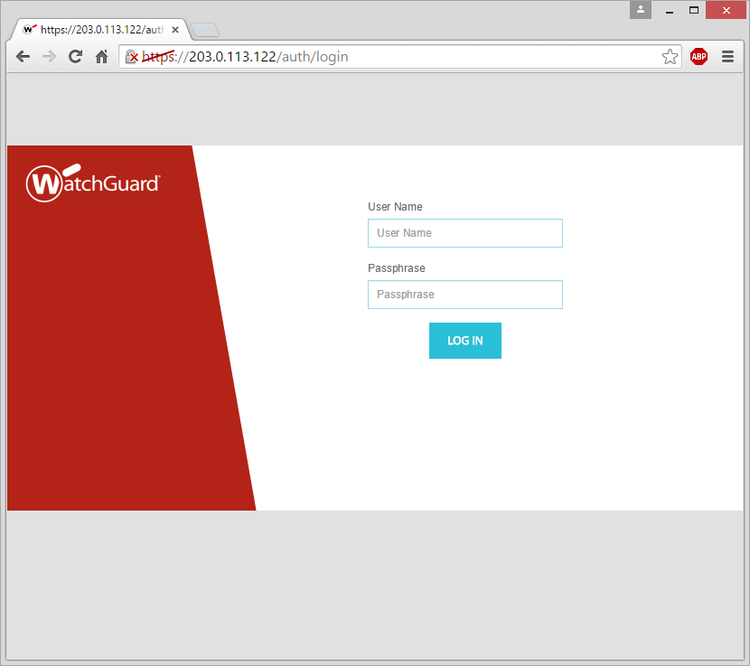
After the Wizard — Log In to Dimension
Multiple super-administrator users can be logged in at the same time
Modes for configuration pages:
Locked (read-only)
Unlocked (read-write)

Slide 28
Configure Dimension

Slide 29
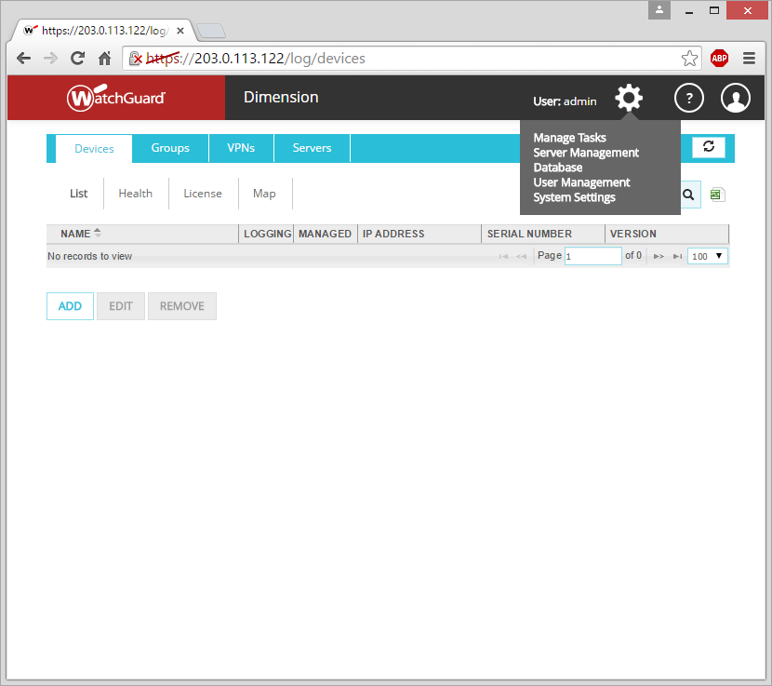
Administration
The (Administration) drop-down list includes menu options to configure, manage, and use Dimension:
Manage Tasks
Schedule Reports
Back Up Database
Restore Database
Server Management
Database
User Management
System Settings

Slide 30
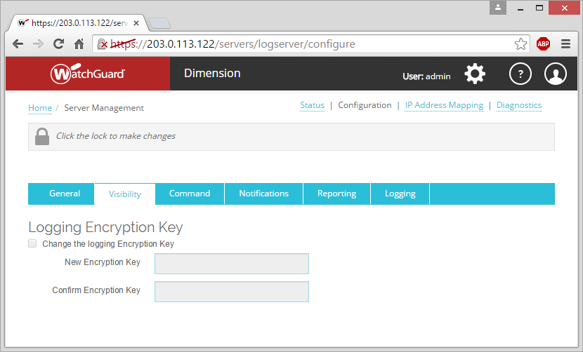
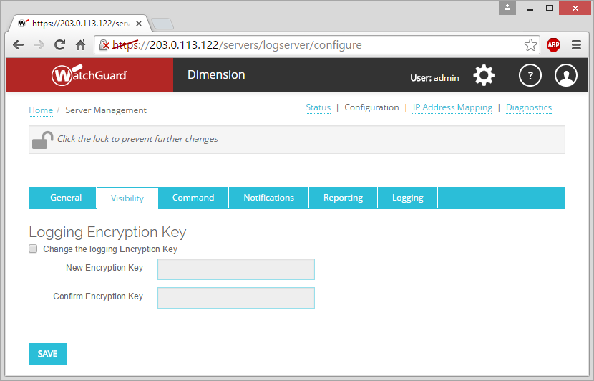
Administration — Lock & Unlock
On the Administration pages, you specify the settings for your instance of Dimension.
Before you can make changes, you must unlock the Dimension configuration.
After you complete your changes, you must lock the configuration.

Slide 31
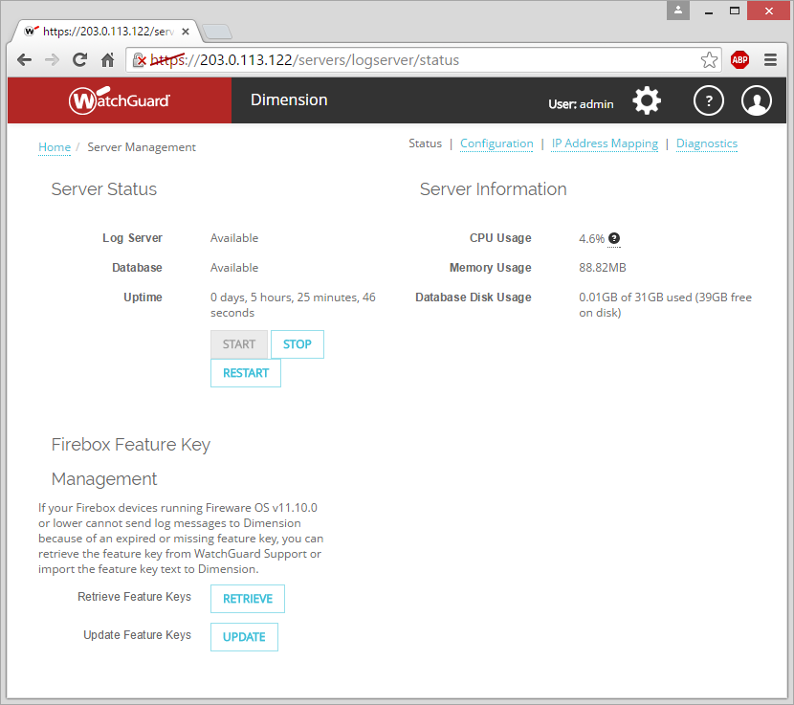
Server Management — Status
On the Status page:
View the status of the Dimension server
Stop and start the Dimension server
View the server CPU, Memory, and Database Disk usage details
Add feature keys for Firebox devices that run Fireware OS v11.10.0 or lower, that you want to manage with Dimension.

Slide 32
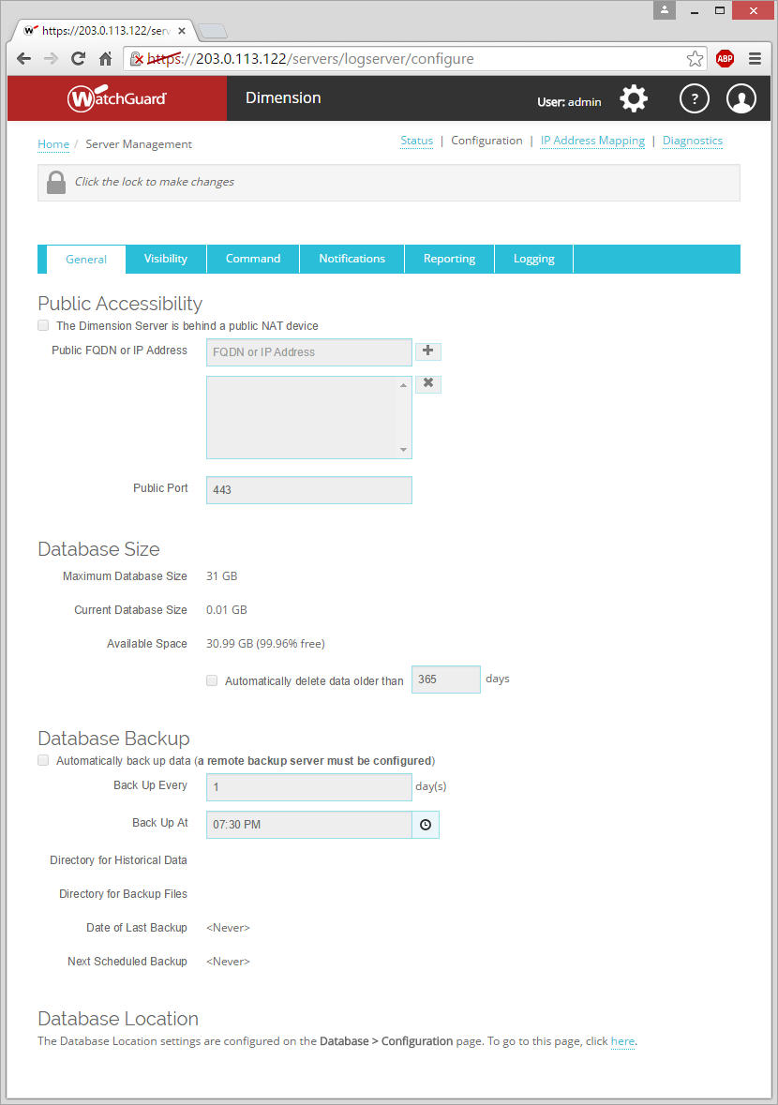
Server Management — Configuration
On the Configuration > General page, you configure these settings for the Dimension server:
Public FQDN or IP address for the public NAT device (such as a gateway Firebox) that Dimension is behind
Specify the log data deletion settings
Specify the database size and automatic back up settings
Specify the database location

Slide 33
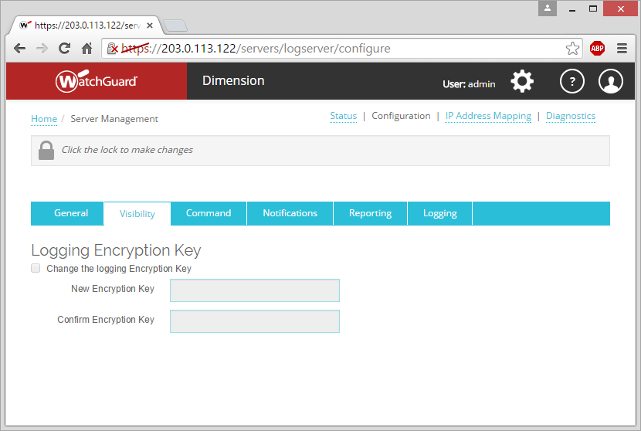
Server Management — Configuration
On the Configuration > Visibility page, you can change the Log Encryption Key for the Dimension server

Slide 34
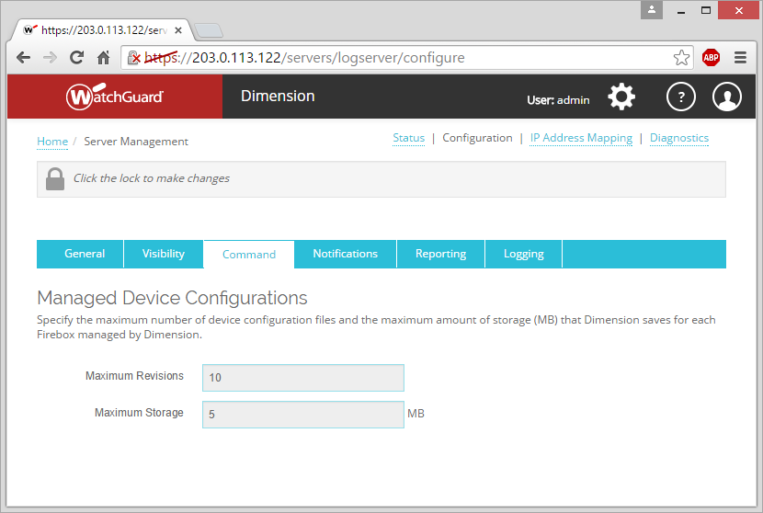
Server Management — Configuration
On the Configuration > Command page, you can specify the number of device configuration file revisions and the amount of storage in MB that Dimension saves for each Firebox managed by Dimension

Slide 35
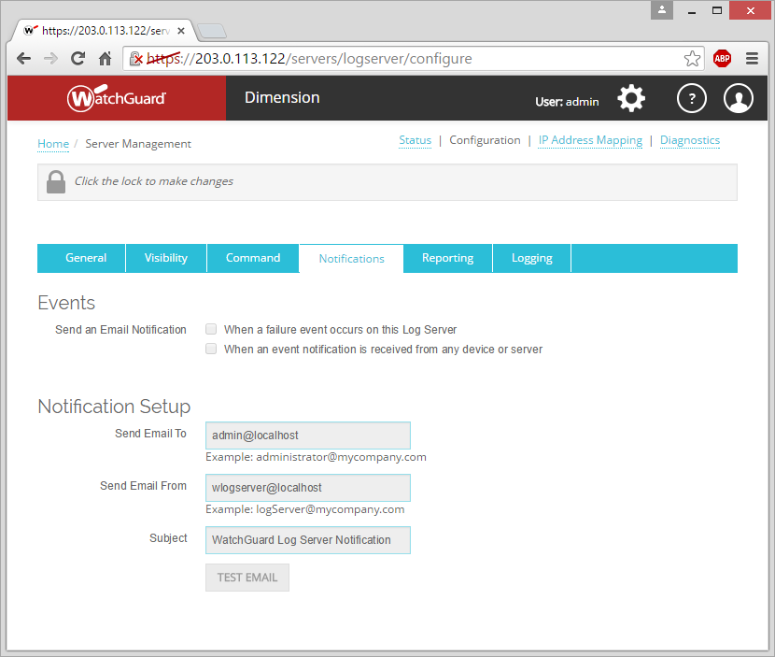
Server Management — Configuration
On the Configuration > Notifications page, configure the settings for email:
Specify what types of event notifications are sent:
Failure Events
Device or Server Event
Specify the email addresses to send notification messages to and from, the subject of notification messages, and test the connection

Slide 36
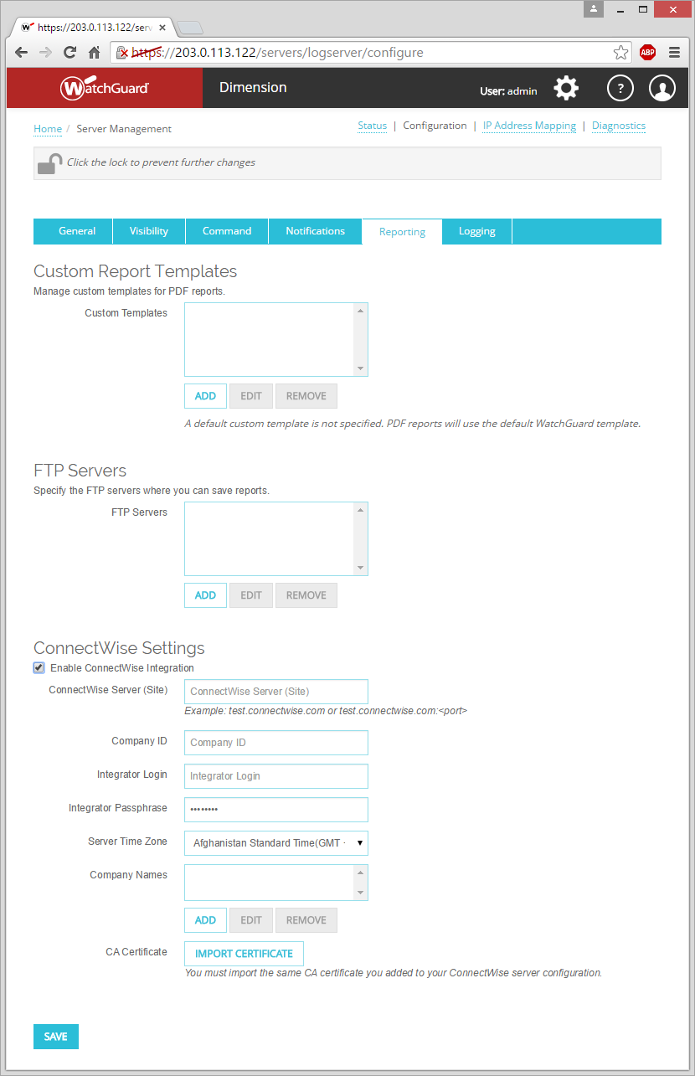
Server Management — Configuration
On the Configuration > Reporting page, configure the settings for reports:
Add Custom Report Templates for report PDFs to specify the:
Header
Footer
Logo
Specify the FTP servers where you can send reports
Configure settings for ConnectWise Integration

Slide 37
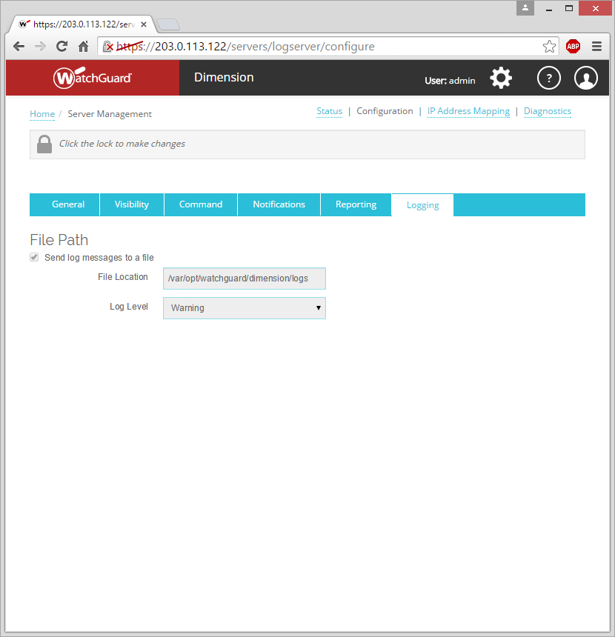
Server Management — Configuration
On the Configuration > Logging page:
Enable logging for the Dimension server.
Select the Log Level for the log messages:
Error
Warning
Info
Debug

Slide 38
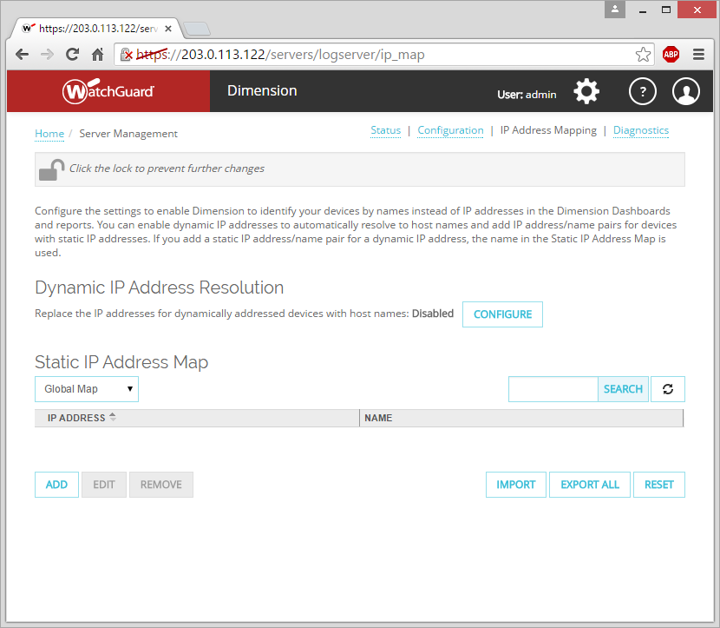
Server Management — IP Address Mapping
On the IP Address Mapping page, configure IP address resolution for dynamically or statically addressed devices.
Some Dimension Dashboards and reports show a name instead of the IP address for the device.

Slide 39
Server Management — IP Address Mapping
Enable Dynamic IP Address Resolution for devices with dynamic IP addresses.
Add an IP address/name pair to the Static IP Address Map list for devices with static IP addresses.

Slide 40
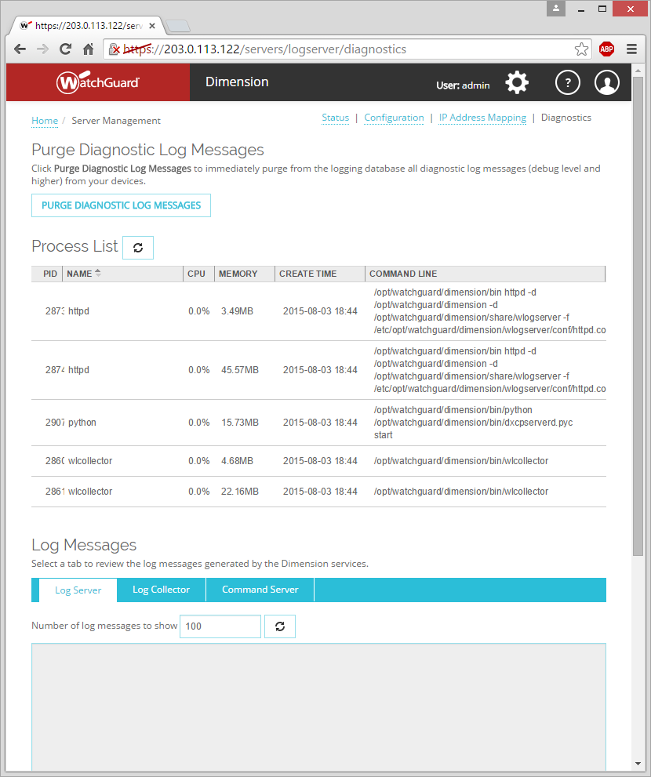
Server Management — Diagnostics
On the Diagnostics page, you can use these diagnostic tools:
Purge diagnostic log messages
View Process List
View Log Messages:
Log Server
Log Collector
Dimension Server

Slide 41
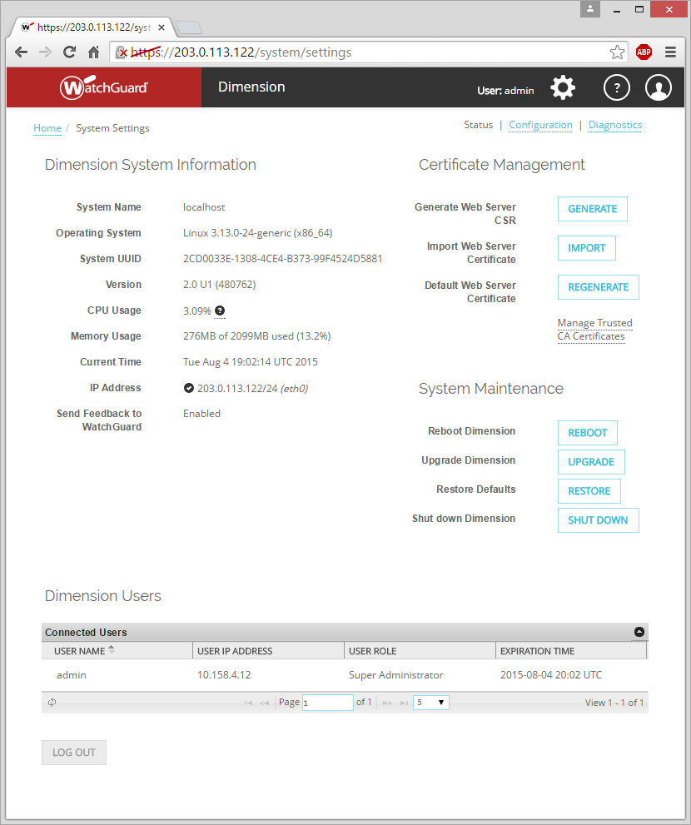
System Settings — Status
On the System Settings > Status page, you can:
Review Dimension system and network settings
Manage certificates
Generate a Web Server CSR
Import a Web Server Certificate
Manage Trusted CA Certificates

Slide 42
System Settings — Status
System Maintenance
Reboot
Upgrade
Restore
Shut down Powers off the VM
View & log out connected users

Slide 43
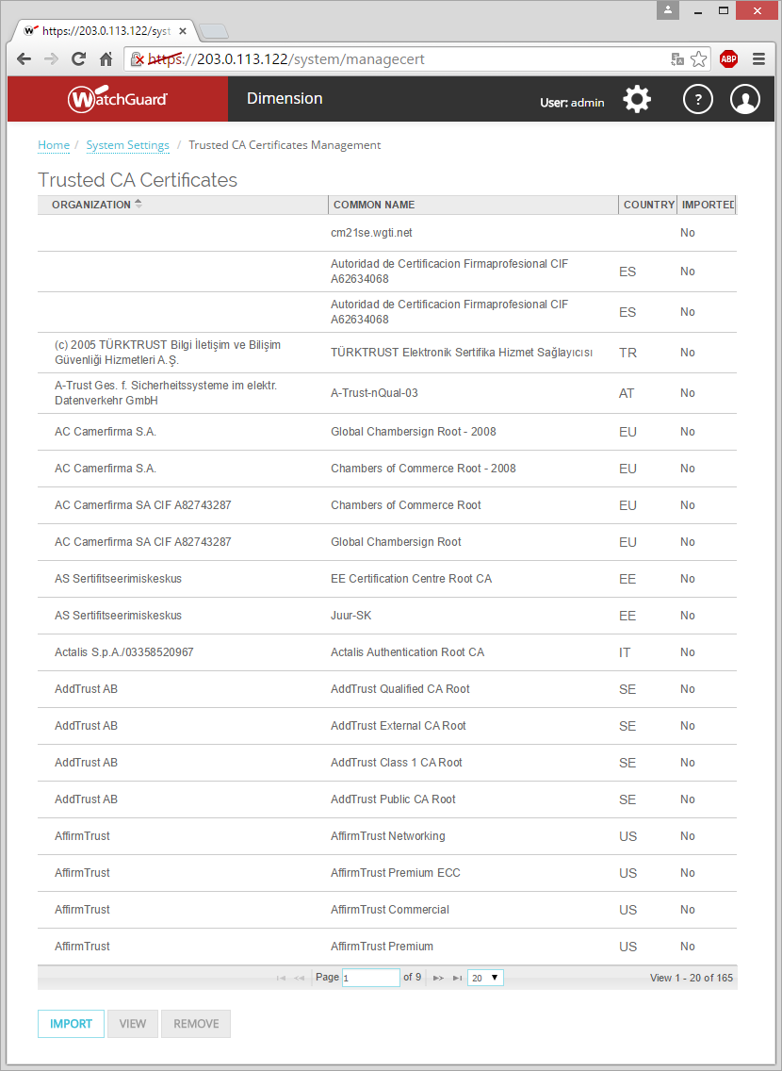
System Settings — Manage CA Certificates
On the System Settings > Status page, Certificate Management section, select Manage Trusted CA Certificates.
Import certificates
View certificates in the list
Remove certificates from the list

Slide 44
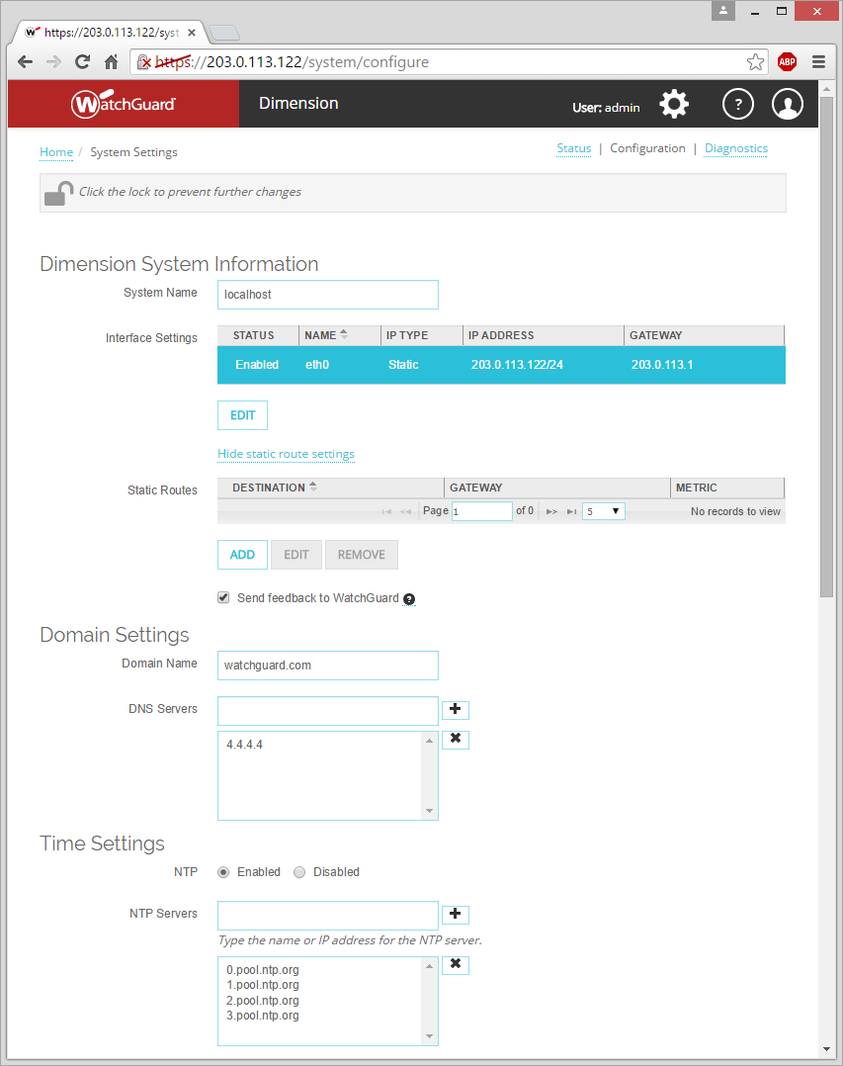
System Settings — Configuration
On the System Settings > Configuration page, you can:
Change the system interface and static route settings
Enable Dimension to send feedback to WatchGuard
Specify the domain settings
Specify the NTP settings and NTP servers for Dimension

Slide 45
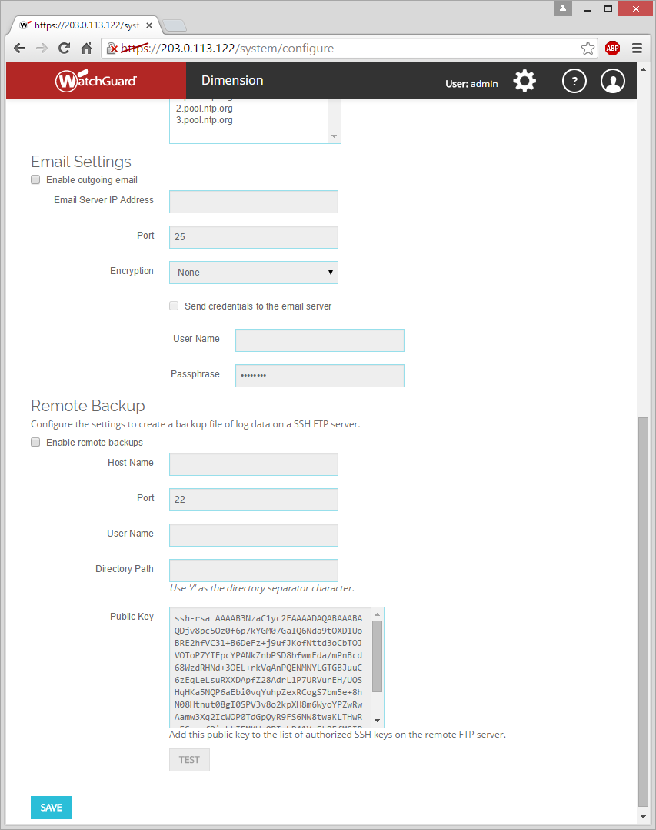
System Settings — Configuration
Enable Dimension to send email notifications and specify the email server information and credentials
Enable Dimension to create backup files of log data on an SFTP server

Slide 46
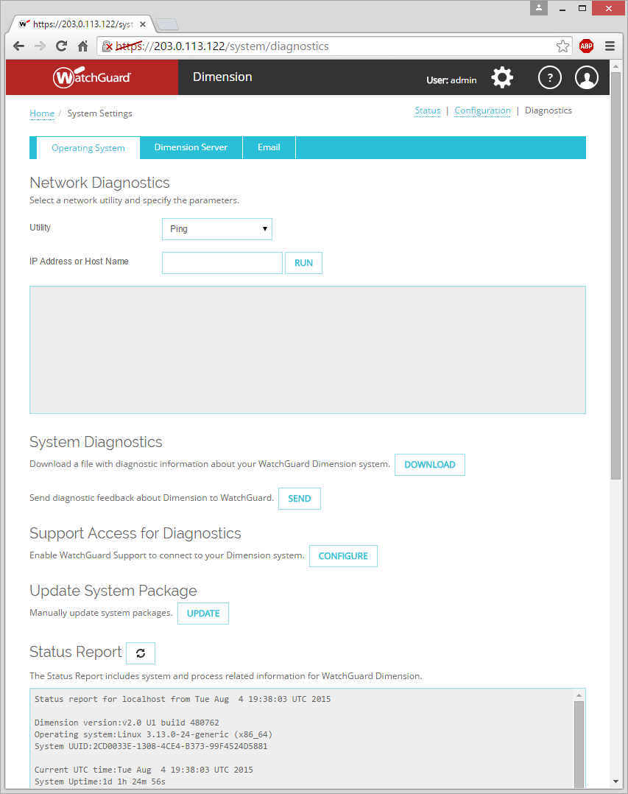
System Settings — Diagnostics
On the System Settings > Diagnostics page, you can run diagnostic tasks for the Dimension operating system, Dimension server, and Dimension email system.

Slide 47
System Settings — Diagnostics
Operating System tasks:
Ping, traceroute, DNS lookup
System Diagnostics
Support Access for Diagnostics
System Package Update
Status Report

Slide 48
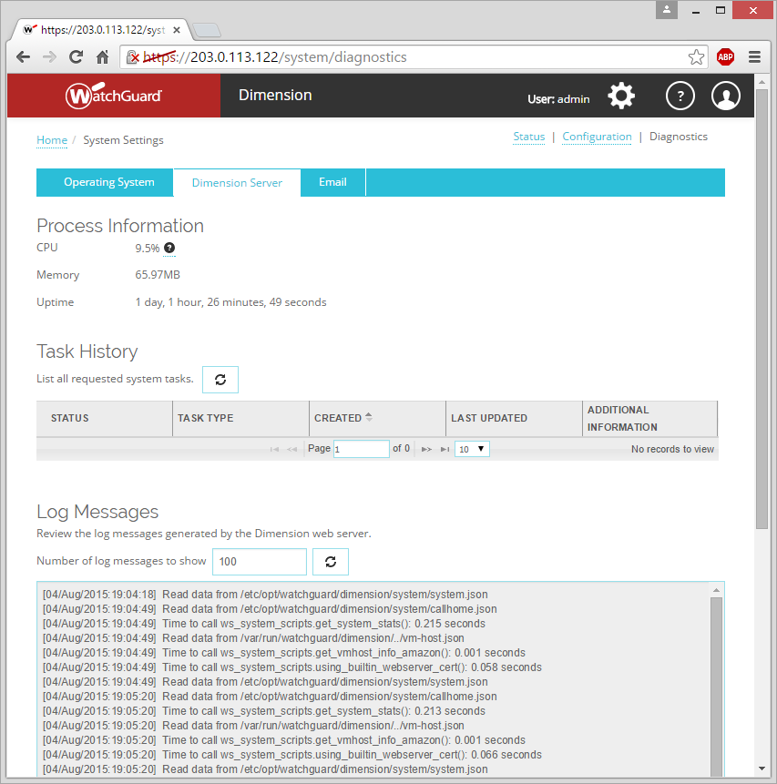
System Settings — Diagnostics
Dimension Server tasks:
Process Information
Task History
Log Messages

Slide 49
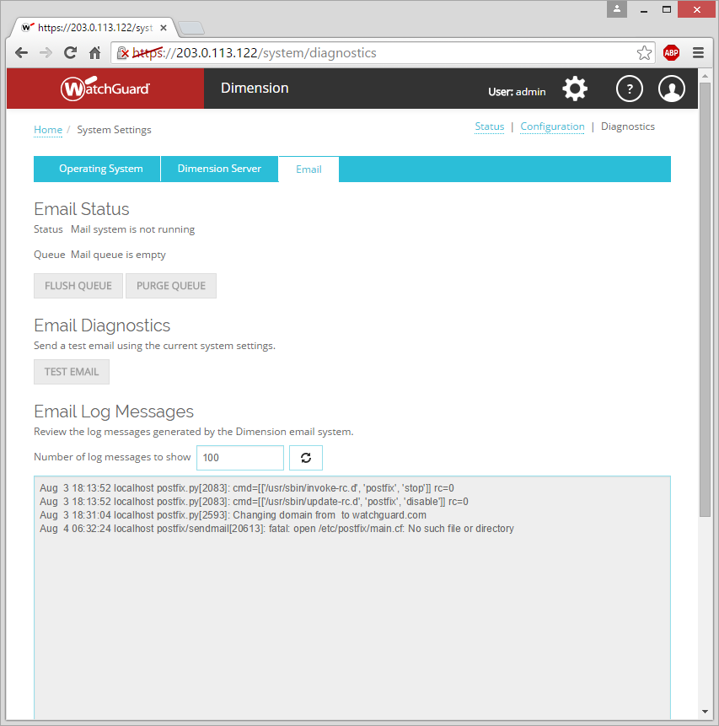
System Settings — Diagnostics
Email system tasks:
Email status
Flush email queue Send all email messages in the queue
Purge Email queue Remove all email messages in the queue
Test email
Review log messages from the Dimension email system

Slide 50
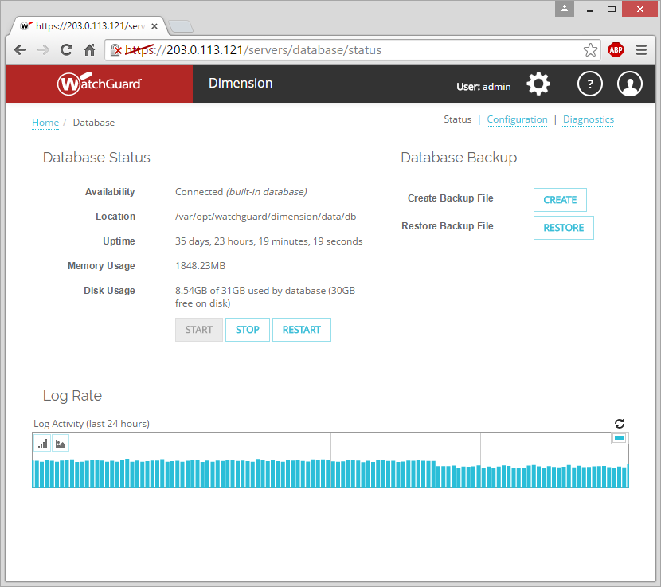
Database — Status
On the Database > Status page, you can monitor the status of the Dimension database.
Database Status
Current database status
Stop & start the database processes

Slide 51
Database — Status
Database Backup
Create or restore a backup file of the database
Does not include historical data
Log Rate
Review the last 24 hours of database activity

Slide 52
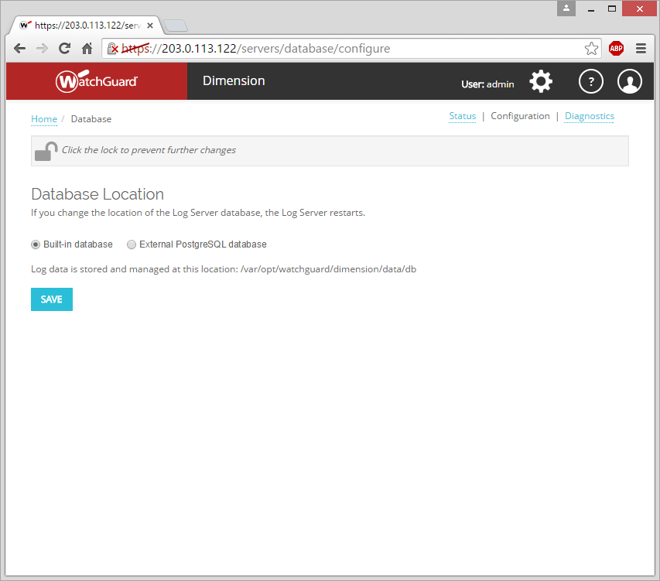
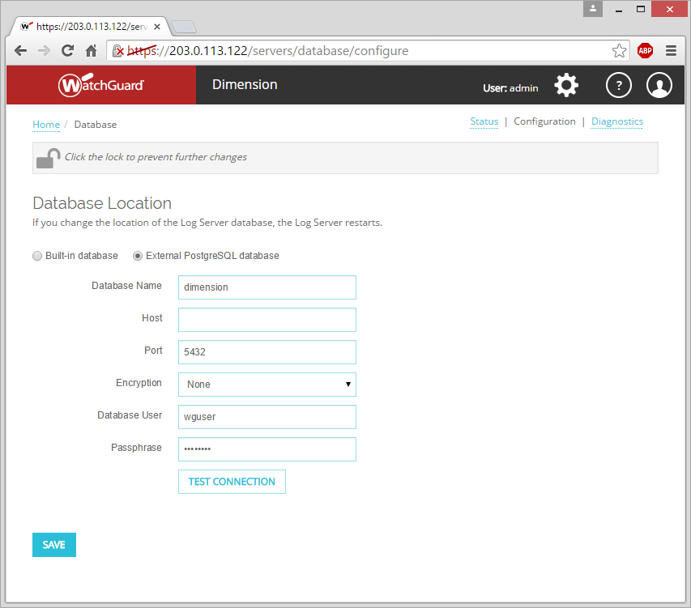
Database — Configuration
On the Database > Configuration page, you can change the location of the Dimension database.
Built-in database
External PostgreSQL database

Slide 53
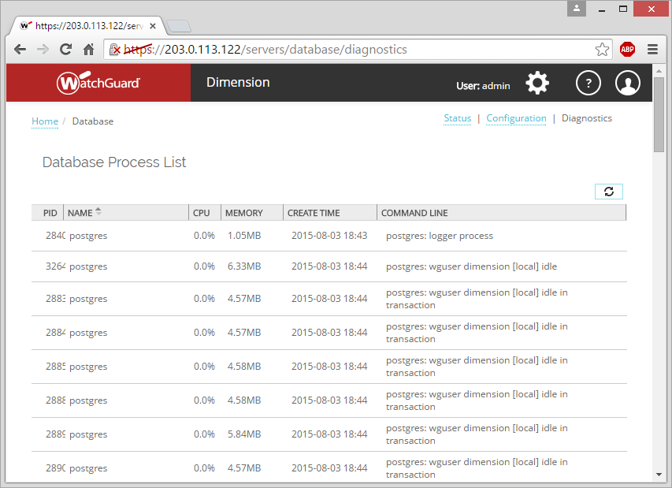
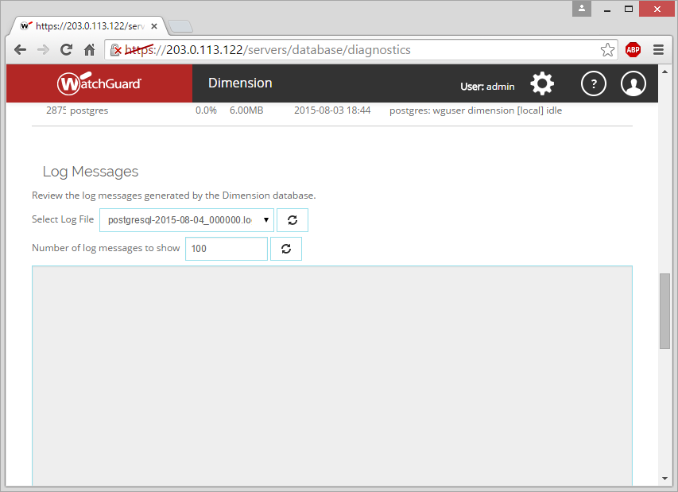
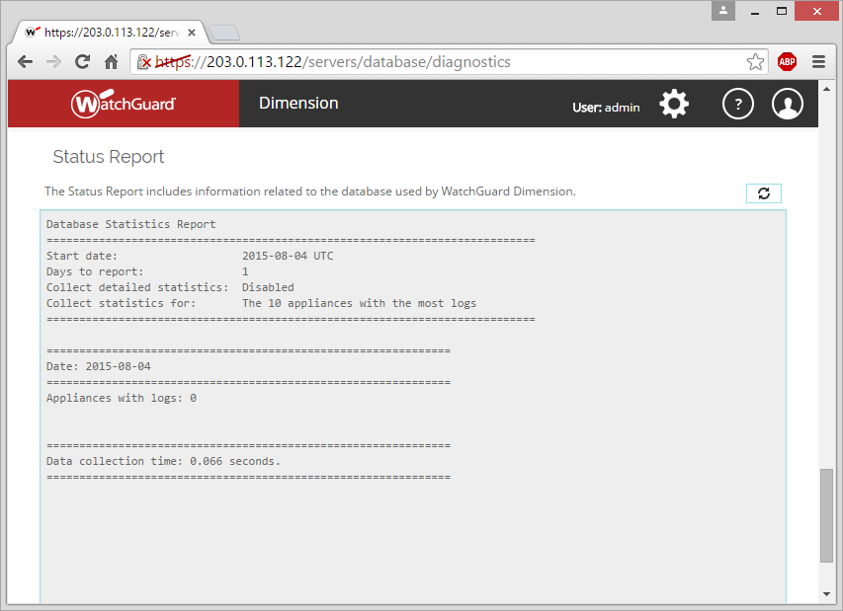
Database — Diagnostics
On the Database > Diagnostics page, you can monitor the status of the Dimension database.
Database Process List
See all the active database processes
Log Messages
View the log messages generated each day
Status Report
See statistics for the devices connected to Dimension

Slide 54
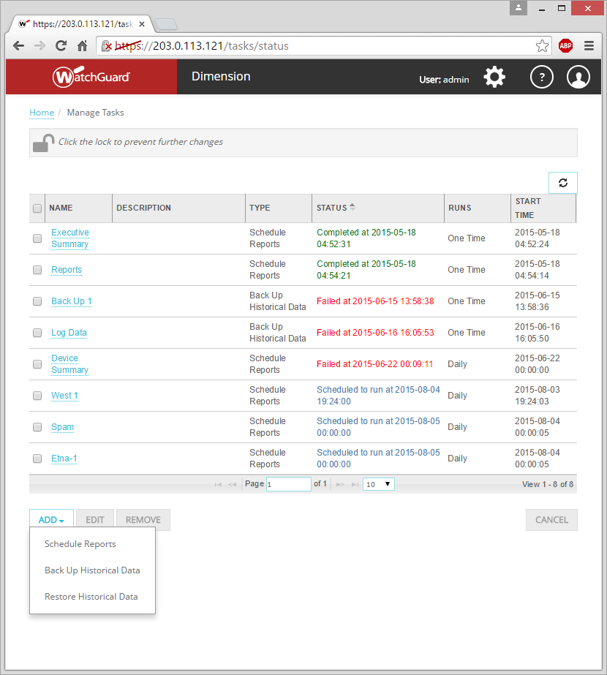
Manage Tasks
From the Manage Tasks page, you can add, edit, or remove these tasks:
Schedule Reports
Back Up Historical Data
Restore Historical Data
Schedule reports to generate repeatedly, but back up & restore of historical data is a one-time task

Slide 55
Manage Tasks — Schedule Reports
Report Schedules
Configuration locked — You can view scheduled reports
Configuration unlocked — You can add a new report schedule, and edit or remove scheduled reports
Before scheduled reports can be sent to a destination, you must configure the settings in Dimension for that destination:
Send in email — Email Settings (System Settings > Configuration)
Send to a directory — FTP Servers (Server Management > Configuration > Reporting)
Send to ConnectWise — ConnectWise Settings (Server Management > Configuration > Reporting)

Slide 56
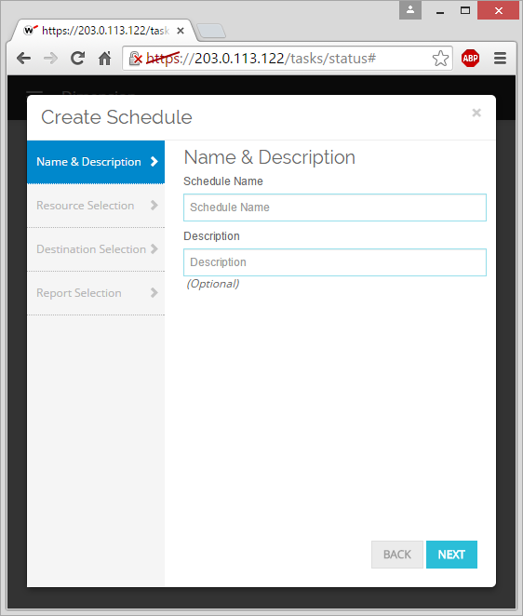
Manage Tasks — Schedule Reports
Add a report schedule:
Select Add > Schedule Reports
Create Schedule > Name & Description settings:
Schedule Name
Description (optional)

Slide 57
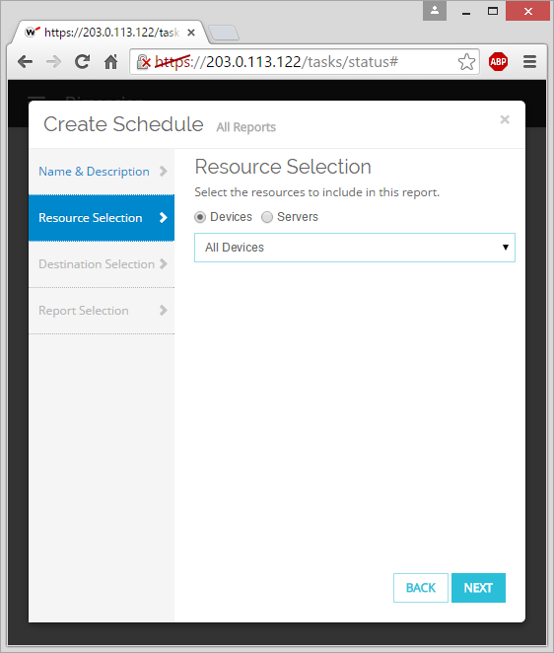
Manage Tasks — Schedule Reports
Resource Selection
Devices:
All Devices
Specify Devices
Servers:
All Servers
Specify Servers

Slide 58
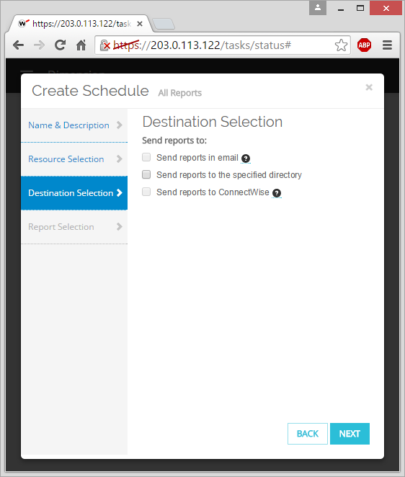
Manage Tasks — Schedule Reports
Destination Selection
Must add at least one destination for the report
Send reports in email
Send reports to a directory on an SFTP server
Send reports to ConnectWise

Slide 59
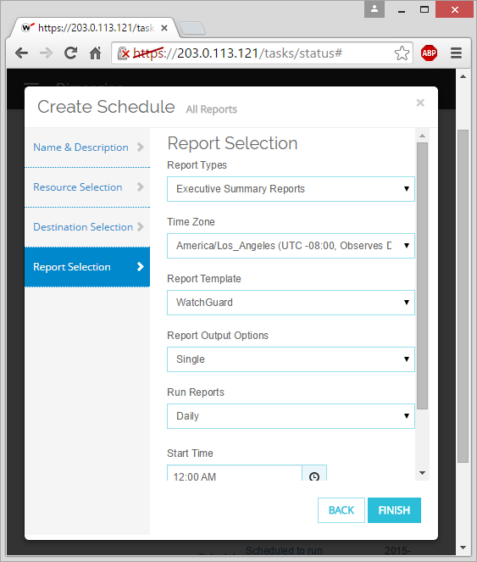
Manage Tasks — Schedule Reports
Report Selection
Report Types
Time Zone
Web-based reports appear in the browser time zone.
Report Template
Use any Custom Template
Report Output Options
Single
Combined
Single & Combined
Notes:
Report Output Options:
Single — Generate a separate report file for each selected report type and each selected device.
Combined — Generate a separate report file for each report type that includes all selected devices.
Single and Combined — Generate a separate report file for each selected report type and each selected device, and generate a separate report file for each report type that includes all selected devices.

Slide 60
Manage Tasks — Schedule Reports
Run Reports
Daily
Weekly
Monthly
Now (Run once)
Start Time
Notes:
Report Output Options:
Single — Generate a separate report file for each selected report type and each selected device.
Combined — Generate a separate report file for each report type that includes all selected devices.
Single and Combined — Generate a separate report file for each selected report type and each selected device, and generate a separate report file for each report type that includes all selected devices.

Slide 61
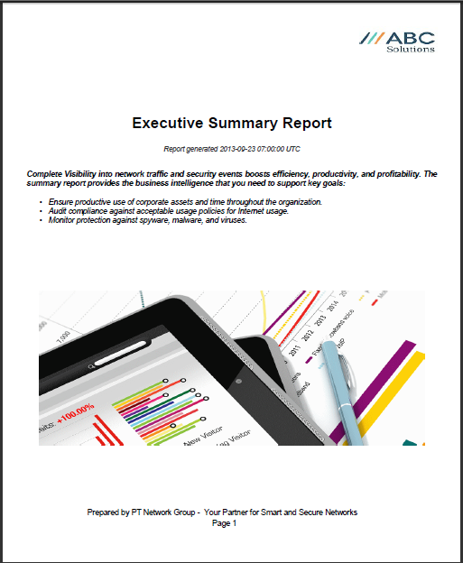
Executive Summary Report
Executive Summary Report
Sent as a PDF file
Specify a logo, header, and footer to customize the report

Slide 62
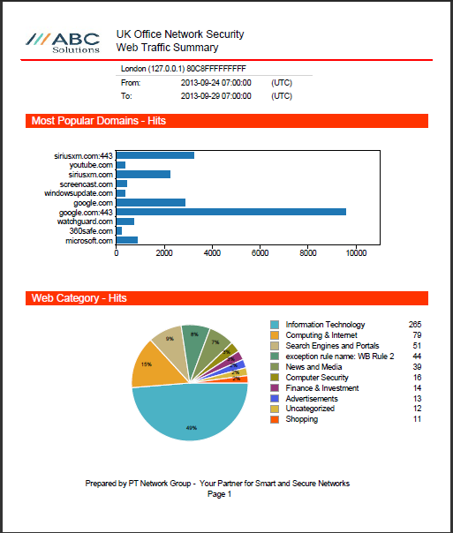
Web Traffic Summary Report
Web Traffic Summary report
Sent as a PDF file
Specify a logo, header, and footer to customize the report
Report includes the Top Domains chart with the Web Categories (in a pie chart), and removes any byte counts or tabular information

Slide 63
Manage Tasks — Back Up Historical Data
Historical data includes, this information for the Firebox devices, FireClusters, and WatchGuard servers that are connected to Dimension:
Device information records
Log messages
Summary report data
Device health statistics
Managed VPN statistics

Slide 64
Manage Tasks — Back Up Historical Data
Before you can back up the historical data in the Dimension database, you must configure Dimension to use a remote backup server and then specify the location of that remote server in the Database Backup Settings.
Select Administration > System Settings > Configuration and complete the Remote Backup settings.

Slide 65
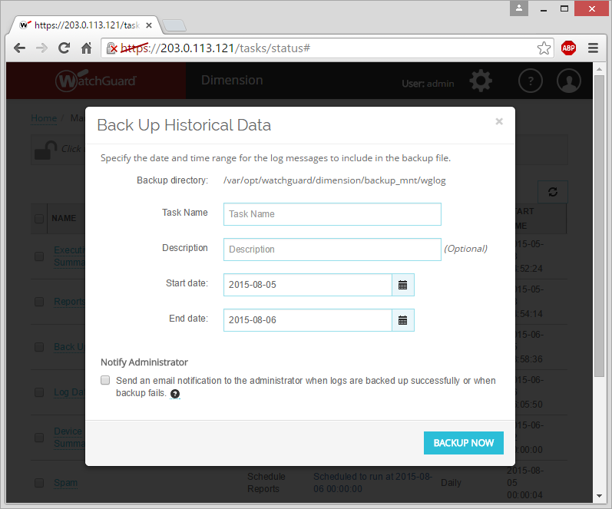
Manage Tasks — Back Up Historical Data
Add a task to back up historical data:
Select Add > Back Up Historical Data
Specify the Task Name and an optional Description of the task
Specify the Start date and End date for the historical data to include in the backup file
Select whether to send a notification to the administrator when the backup is created or fails

Slide 66
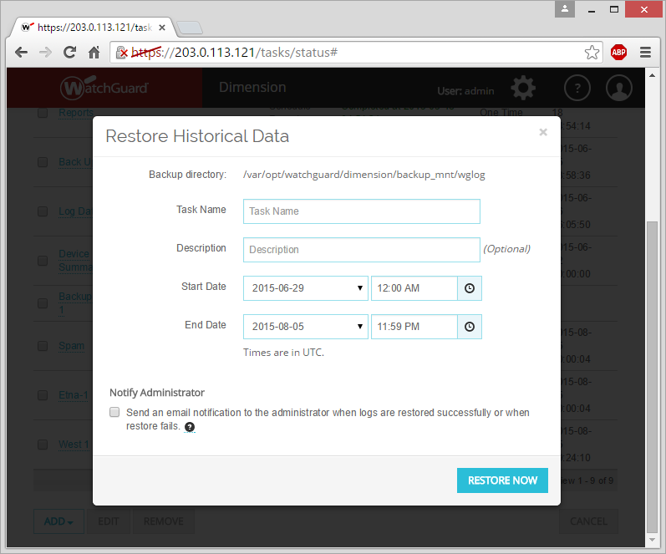
Manage Tasks — Restore Historical Data
Add a task to restore historical data to the Dimension database:
Select Add > Restore Historical Data
Specify the Task Name and an optional Description of the task
Specify the Start date and time and End date and time for the historical data to restore to the database

Slide 67
Manage Tasks — Restore Historical Data
Select whether to send an email notification to the administrator when the backup file is successfully restored or when the restore fails

Slide 68
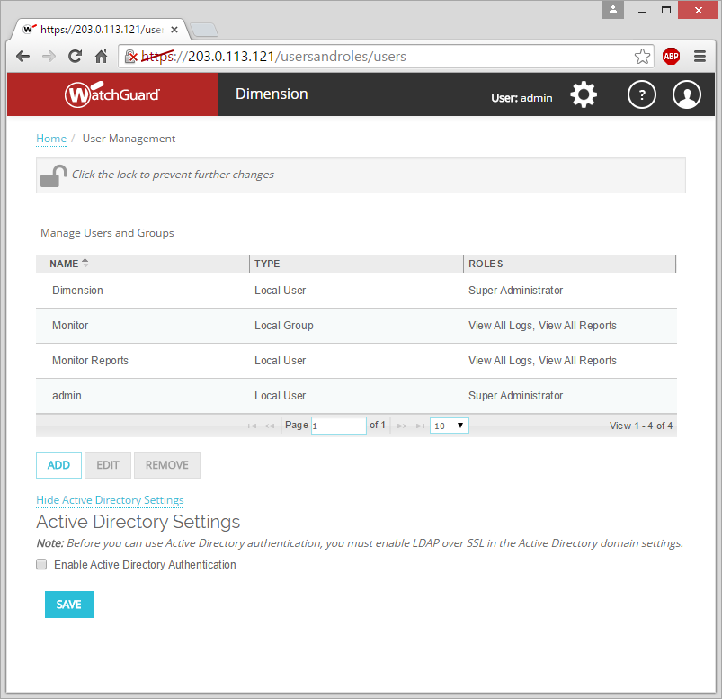
User Management
On the User Management page, you can manage the local users that can connect to Dimension.
Add users and assign roles to the users to specify what parts of Dimension each user can get access to.

Slide 69
User Management
Enable Dimension to connect to your Active Directory server to get user credentials and group information.

Slide 70
User Management
Manage Users and Groups
Add, edit, or remove users
Specify roles for users
Select devices for users
Active Directory Settings
Enable Active Directory Authentication

Slide 71
User Management
Enable Active Directory Authentication
Enable Dimension to connect to your Active Directory server so you can add users to Dimension from your Active Directory server.
LDAPS must be enabled on your Active Directory server.

Slide 72
User Management
Dimension includes these roles for role-based administration that you can assign to local users:
User:
Local authentication
Active Directory User
Active Directory Group
Devices:
List of devices that send log messages to Dimension
Roles that apply to all devices:
Super Administrator (All access)
Report Administrator (Schedule reports, manage groups, view logs, view reports)
Roles that can be applied to individual devices and groups:
View Logs
View Reports

Slide 73
User Management
Role policies function as they do in WSM:
User + List of roles + List of Devices
User authentication is similar to WSM:
Local user, AD user, AD Group
AD requires DNS to resolve DCs by internal domain name
Built-in roles only
You cannot add custom roles
Applied to a list of devices

Slide 74
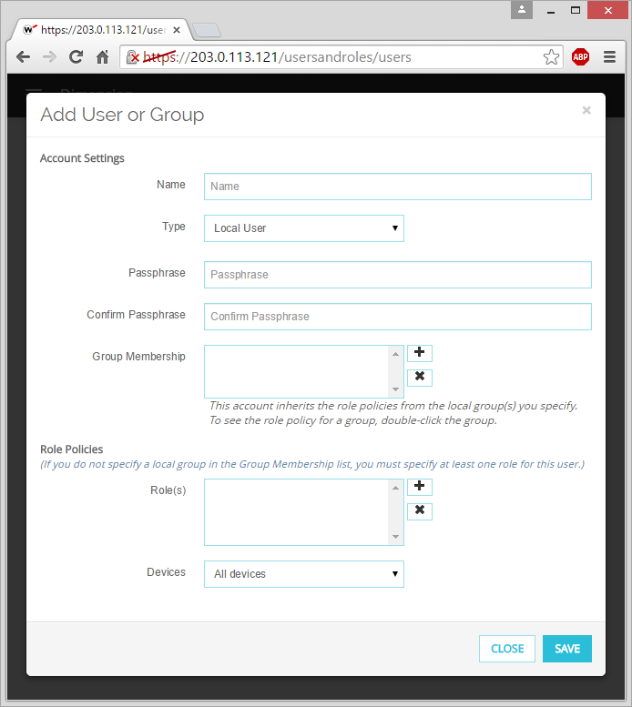
User Management
Add a User
Select the Type of user (the location of the user account):
Local User
AD User
AD Group
Specify the user name
Use the format specified for the user type you selected
Set the passphrase

Slide 75
User Management
Select a role for the user:
Roles for All Devices:
Super Administrator
Global Administrator
Global Monitor
Report Administrator
View All Logs
View All Reports

Slide 76
User Management
Roles for Specific Devices:
Device Administrator
Device Monitor
VPN Administrator
VPN Monitor
View Logs
View Reports

Slide 77
User Management
Select devices for the user:
Add any Firebox in the Available list to the Selected list
Use the Search text box to find a Firebox in the list of available devices

Slide 78
Use Dimension

Slide 79
Use WatchGuard Dimension
WatchGuard Dimension is a virtual visibility and management solution you can use to capture the log data from your Firebox devices, FireClusters, and WatchGuard servers, and manage your Firebox devices and FireClusters.
Management from Dimension
To use the Dimension management features, each Firebox or FireCluster must have a feature key with the LiveSecurity Service and Dimension Command features enabled
Add your Firebox devices and FireClusters to Dimension to centrally manage and control the configurations and settings of each Firebox device
Create managed VPNs between Firebox devices and FireClusters managed by Dimension

Slide 80
Use WatchGuard Dimension
Logging & Reporting from Dimension
To use the logging & reporting features in Dimension, each Firebox or FireCluster must have a feature key with the LiveSecurity Service feature enabled
See log data in real-time
Track traffic across your network
View the source and destination of traffic
View log message details of the traffic
Monitor threats to your network
View reports of the traffic

Slide 81
Management with Dimension

Slide 82
Management with Dimension
After you add your Firebox devices and FireClusters to Dimension, you can manage them with Dimension.
Manage the device configuration file for each Firebox or FireCluster
Manage VPN tunnels between Firebox devices managed by Dimension

Slide 83
Management with Dimension — Device Management
Open Fireware Web UI for managed devices directly from Dimension
Normal configuration and device management
Select Actions > Open Fireware Web UI

Slide 84
Management with Dimension — Device Management
Resolve issues identified in Dashboard pages, log messages, and reports
Click a link on a Dashboard page to open Fireware Web UI and resolve the issue

Slide 85
Management with Dimension — Device Management
Dimension stores the configuration files for the Firebox devices and FireClusters it manages
Each time you change the configuration file, even if the changes are made outside of Dimension, a new revision is stored and appears in the Configuration History list.

Slide 86
Management with Dimension — Managed VPNs
On the VPNs page, create managed hub-and-spoke VPNs between managed devices
Select Home > VPNs
Click Add to start the Create VPN Wizard to set up a managed VPN

Slide 87
Management with Dimension — Managed VPNs
Select the Hub Device
This is a Firebox managed by Dimension
Select a BOVPN Type
Traditional BOVPN (Recommended)
Virtual Interface BOVPN

Slide 88
Management with Dimension — Managed VPNs
Specify a name for the managed VPN
This is the name that appears on the VPNs page, in the Dashboard pages, and in the reports for VPNs
You cannot change the VPN Name after the VPN is created

Slide 89
Management with Dimension — Managed VPNs
Specify the External Interfaces to use for the managed VPN
You can add more than one interface to use for failover
If you add more than one external interface, make sure the first interface in the list is the primary external interface of the Firebox you selected as the Hub device

Slide 90
Management with Dimension — Managed VPNs
Specify the VPN Resources to use for the managed VPN
Specify the IP addresses that the Spoke devices can use to connect to tunnel routes
Specify the Direction of the traffic through the BOVPN tunnel
(Optional) Enable 1:1 NAT

Slide 91
Management with Dimension — Managed VPNs
After you add the Hub device to the VPN, you can edit the Hub device settings to configure the security settings for the VPN
Click Edit Hub Settings

Slide 92
Management with Dimension — Managed VPNs
Specify Phase 1 Settings:
Select whether to use NAT Traversal and specify the Keep-alive interval in seconds
Select whether to use IKE Keep-Alive and configure the related settings
Select whether to use Dead Peer Detection and configure the related settings

Slide 93
Management with Dimension — Managed VPNs
Specify Phase 1 Transform settings:
Select an Authentication method
Select an Encryption method
Specify the SA Lifetime (hours)
Select a Diffie-Hellman Key Group

Slide 94
Management with Dimension — Managed VPNs
Specify Phase 2 Settings:
Enable PFS and select a Diffie-Hellman group
Select an Authentication method
Select an Encryption method
Select a Force key expiration option:
By Time (in hours)
By Traffic (in number of kilobytes sent through the VPN)

Slide 95
Management with Dimension — Managed VPNs
After you add the Hub device to the VPN, add one or more Spoke devices to the VPN
In the Spokes section, click Add

Slide 96
Management with Dimension — Managed VPNs
In the Add Spoke Gateway wizard, select a Firebox to add as the Spoke device.
This can be any Firebox managed by Dimension, except for the Hub device.

Slide 97
Management with Dimension — Managed VPNs
Add the External Interfaces on the Spoke device to use for traffic through the VPN tunnel.
By default, the list includes the external interface configured on the Firebox you specified as the Spoke device.

Slide 98
Management with Dimension — Managed VPNs
If you add more than one external interface to the list, make sure the first interface in the list is the primary external interface on the Firebox.

Slide 99
Management with Dimension — Managed VPNs
Select the Tunnel Mode:
Specify Traffic Routes Over VPN (Recommended)
Send All Traffic Over VPN

Slide 100
Management with Dimension — Managed VPNs
Add routes to the Route From list:
Specify the IP address of the external interface on the Spoke device
Select the direction of traffic over this IP address:
Bi-directional (Recommended)
Hub-to-Spoke
Spoke-to-Hub

Slide 101
Management with Dimension — Managed VPNs
(Optional) Select the Enable 1:1 NAT check box and type the host address or network address to use

Slide 102
Management with Dimension — Managed VPNs
If you selected Specify Traffic Routes Over VPN:
In the Route To list, the external IP addresses of the Hub device appear
You can change which external IP addresses on the Hub device the Spoke device can connect to

Slide 103
Management with Dimension — Managed VPNs
Select the Firewall Policies in your Spoke device configuration file to apply to the traffic through the managed VPN:
Default options:
Any (Recommended) — The default Any policy included in your device configuration file

Slide 104
Management with Dimension — Managed VPNs
None — No policy will be applied to the traffic through the managed VPN
You can also select another firewall policy from your Firebox configuration that appears in the Firewall Policies list

Slide 105
Management with Dimension — Managed VPNs
The Spoke device appears in the Hub and Spoke VPN map and in the Spokes list:
Hub device — Round
Spoke device — Square
Line between icons shows the connection status:
Solid — Active
Dotted — Inactive
Hub
Spoke
Inactive Connection

Slide 106
Management with Dimension — Managed VPNs
Icon color shows the tunnel status:
Green frame — At least one active tunnel
Green solid — All tunnels are active
Grey — No VPN health data
Red — No active tunnels
Hub
Spoke
Inactive Connection

Slide 107
Logging & Reporting with Dimension

Slide 108
Logging & Reporting with Dimension
To get the most out of the logging and reporting features of Dimension, make sure to:
Select Enable logging for reports in proxy actions on your Firebox devices
Enable logging of Allowed Packets in all policies on your Firebox devices
Enable logging for Subscription Services and other features on your Firebox devices
Configure your Firebox devices and WatchGuard servers to send all log messages to your Dimension server

Slide 109
Logging & Reporting with Dimension
When logging is enabled on your Firebox, and your Firebox is configured to send log messages to Dimension, you can see details from the log messages in the Dimension dashboards and reports.
Dashboards only include the widgets for available data.
Reports only appear for available data.

Slide 110
Logging & Reporting with Dimension
Logging Enabled For… | Dashboards | Reports
Packet Filter Traffic (Allowed) | Executive, Threat Map, FireWatch, Policy Map | Web, Packet Filter, Top Client, Application Control
Packet Filter Traffic (Denied) | Security, Threat Map, Policy Map | Web, Packet Filter, Denied Packet, Top Client, Application Control
APT Blocker | Executive, Security, Policy Map | APT Summary and Detail reports, PCI Compliance, Executive Summary PDF
Intrusion Prevention | Security, Threat Map, Policy Map | IPS, Denied Packet
Configuration changes |  | Authentication, Audit
All Proxies | Executive, Security, Threat Map, FireWatch, Policy Map | GAV, IPS, SPAM, Application Control
HTTP Proxies | Executive, Security, Threat Map, FireWatch, Policy Map | Web, Firebox Statistics, RED
FTP Proxies | Executive, Security, Threat Map, FireWatch, Policy Map | Firebox Statistics
SMTP Proxies | Executive, Security, Threat Map, FireWatch, Policy Map | SMTP, Firebox Statistics
POP3 Proxies | Executive, Security, Threat Map, FireWatch, Policy Map | POP3, Firebox Statistics
WebBlocker Actions | Executive, Security, Threat Map, FireWatch, Policy Map | Web Audit
Any alarms |  | GAV, Alarms

Slide 111
Executive Dashboard
Executive Dashboard Widgets
Top Zero-Day Malware (APT)
Top Clients
Top Domains
Top URL Categories
Top Destinations
Top Applications
Top Application Categories
Top Protocols

Slide 112
Executive Dashboard
Click a summary widget to expand it and see more detail

Slide 113
Security Dashboard
Security Dashboard Widgets
Top Blocked Advanced Malware (APT)
Top Blocked Clients
Top Blocked Destinations
Top Blocked URL Categories
Top Blocked Applications
Top Blocked Application Categories
Top Blocked Protocols

Slide 114
Security Dashboard
IPS Signatures
Gateway AntiVirus
Click a summary widget to expand it and see more detail

Slide 115
Threat Map
Denied Packets (Blocked)
Intrusion Prevention Service
Web Traffic
Application Control
All Traffic

Slide 116
FireWatch
Shows IPv4 & IPv6 addresses
Sort by:
Source
Destination
Domains
Application
Web Audit
Protocol

Slide 117
FireWatch
Pivot on:
Bytes (Only for packet filter traffic for Fireware OS v11.8 or higher)
Connections
Hover for more detail:
Filter further
Show connections
Full screen mode

Slide 118
Policy Map
Interactive tool that aggregates the traffic through your Firebox devices and shows the traffic in a visualization of the traffic flows.
Traffic flows appear as ribbons that flow through the connections the traffic makes.

Slide 119
Policy Map
Policy Map shows the number of flows, bytes, and connections that are included in the traffic flow.

Slide 120
Policy Map
Filter Policy Map on:
Subscription Services activity
Application activity through policies
Policies in use
Users in policy flows
Policies that uses the most bandwidth
Connections between the Trusted and Optional interfaces
Interfaces in use
Connections between active interfaces

Slide 121
Policy Map
Pivot Policy Map on:
Bytes
Connections (Not available for the Web Audit filter)

Slide 122
Policy Map
See the traffic flow
The traffic flow ribbon passes through the connection columns in the Policy Map

Slide 123
Policy Map
See the traffic flow details
Number of connections
Filter the Policy Map on the selected traffic flow
View connections in Policy Map for the selected traffic flow

Slide 124
Policy Map
Filtered view of the selected traffic flow

Slide 125
Policy Map
View connections from the selected traffic flow

Slide 126
Log Manager
Log messages stored in UTC time
Appears in your web browser’s local time

Slide 127
Log Search
Run simple or complex search queries to refine log messages for the selected Firebox.
Filter search results by log message type:
Traffic
Alarm
Event
Diagnostic
Statistic
All

Slide 128
Per Client Reports
Summary & Detail reports
Includes information from proxy log messages about an authenticated user, host name, or an IP address
Detailed activity summary for the selected client and the time range

Slide 129
Per Client Reports
Collapse and expand the selection criteria section.
Specify at least one of these options:
User name or ID
IP address
Host name
For a Data Loss Prevention report, you can also specify these options:
Policy name
Rule name (required)

Slide 130
View Reports
On the Reports tab for a device, group, or server, you can expand a report type and select many of the same reports that are available on your WatchGuard Report Server

Slide 131
View Reports
On a report, select options to pivot on from the pivot drop-down list
Export the report to a PDF file

Slide 132
Use Dimension in Another Language
The Dimension user interface is localized into these languages:
French
Spanish (Latin America)
Japanese
Korean
Traditional Chinese
Simplified Chinese
Explanatory text included in the Executive Summary and Compliance reports is also localized, when you view them in your web browser, or generate a PDF from a web browser view.
PDF reports that are generated from a schedule do not include localized text.

Slide 133
Support WatchGuard Dimension

Slide 134
Dimension Support — Console Access
Console shows command line access
Log in with the wgsupport/readwrite credentials
Change the password on initial login
Account restricted to only find or change the IP address
To set a static IP address, use the command wg_ip_addr.sh, located in /opt/watchguard/dimension/bin.
For example, to set a static IP address of 192.168.24.101 on network 192.168.24.0/24 with gateway 192.168.24.1, type:
/opt/watchguard/dimension/bin/wg_ip_addr.sh -i 192.168.24.101 -m 24 -g 192.168.24.1
When given without any options, or with the option --help, the command displays help text.

Slide 135
Dimension Support — Console Access
To find the external IP address, run the ifconfig command.
To find the Eth0 IP address and interface configuration details, run the ip addr show command.
To find the route information for Eth0, run the ip route show command.
Support access for diagnostics is available with a connection restricted by a client-side certificate.

Slide 136
Dimension Support — Known Limitations
Cannot import log files to Dimension
Certificates must use CSR
No external private key

Slide 137
Thank You!

